Slide 1


Comparative Analysis of Inflectional and Derivational Morphology
DSA0304 - NATURAL LANGUAGE PROCESSING
Presented by:
M. Yasodha Krishna - 192472100

Slide 2
Introduction to Morphology
Morphology is the study of word formation and structure.
It examines how words are built using morphemes.
Morphemes are the smallest units of meaning in a language.
Example
Playing = Play + ing
Books = Book + s
Unhappy = Un + Happy
Morphology is divided into:
Inflectional Morphology
Derivational Morphology

Slide 3
Inflectional Morphology
Changes the grammatical form of a word.
Does not create a new word.
The word's basic meaning remains the same.
Used to indicate:
Tense
Number
Gender
Person
Examples
play → played
book → books
walk → walking

Slide 4
Derivational Morphology
Derivational morphology is the process of creating a new word.
It is done by adding a prefix or suffix to a root word.
It changes the meaning of the word.
It may also change the word type (noun, verb, adjective, etc.).
It helps computers understand new words in NLP.
Examples
Happy → Happiness
Teach → Teacher
Write → Rewrite
Care → Careless
Use → Useful

Slide 5
Comparative Analysis
Feature | Inflectional | Derivational
Creates New Word | No | Yes
Changes Meaning | Little | Significant
Changes Word Class | No | Often Yes
Purpose | Grammar | Word Formation
Base Word | Inflectional | Derivational
play | played | player
happy | happier | happiness

Slide 6
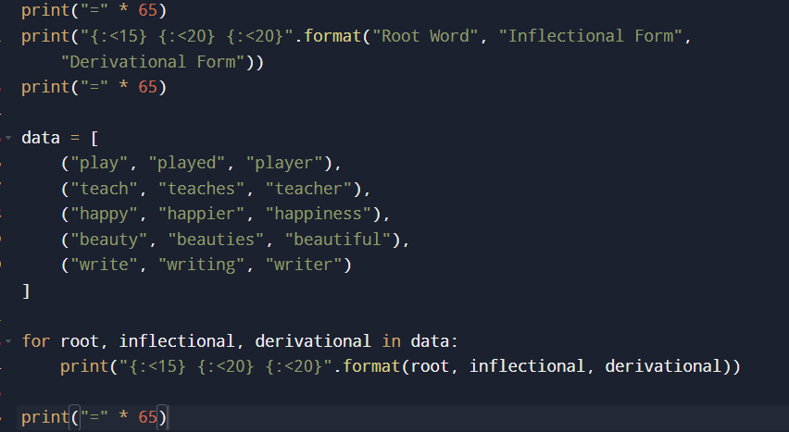
IMPLEMENTATION

Slide 7
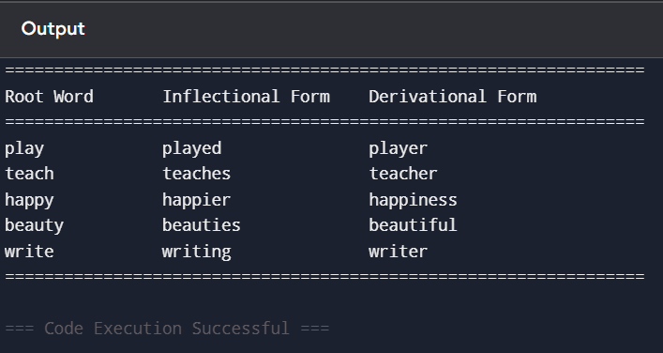
OUTPUT

Slide 8
Challenges & Applications
Challenges
Ambiguous word forms
Complex language rules
Handling unseen words
Morphological variations across languages
Applications in NLP
Machine Translation
Speech Recognition
Search Engines
Chatbots
Text Analytics

Slide 9
CONCLUSION
Inflectional morphology changes the grammatical form of a word without changing its meaning or word class.
Derivational morphology creates new words and often changes the word's meaning or grammatical category.
Both are important for understanding how words are formed and used in a language.
In Natural Language Processing (NLP), inflectional morphology helps identify grammatical relationships, while derivational morphology helps understand vocabulary and word meanings
Overall, inflectional and derivational morphology work together to help computers process and understand human language more accurately.

Slide 10
Thank You!

